Slide 1


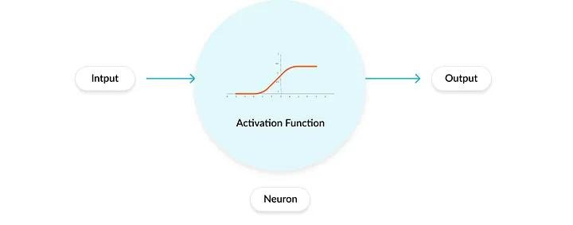
Activation Functions
ll
What are they and how do they help in machine learning!
Introduction
Definition and role in neural networks
Why non-linearity is essential in deep learning
Types of Activation Functions
Linear Activation Function
Non-linear Activation Functions
Activation Functions in Deep Neural Network Training
The vanishing and exploding gradient problems
Conclusion
Future directions in the research and development of activation functions
Atanda Abdullahi Adewale, 2024

Slide 2
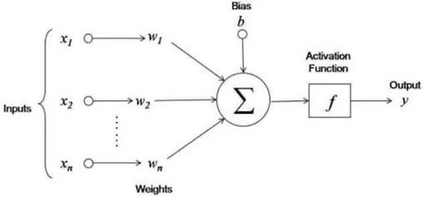
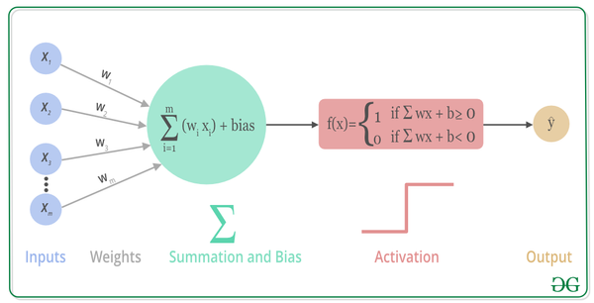
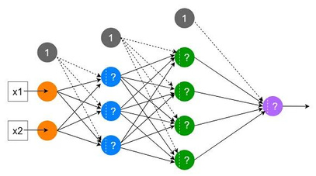

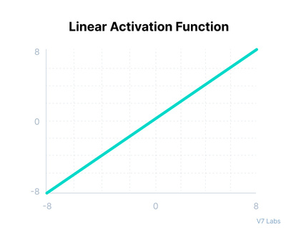
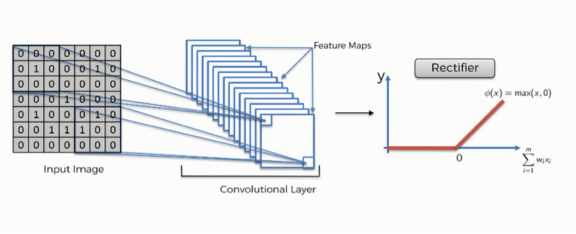
Types of Activation Functions
Linear Activation Function also known as "no activation," or "identity function"
Linear activation functions: Output is a linear transformation (directly proportional) of the input.
Basic example is f(x)=x or f(x)=ax+b a = coefficients or weights
Layer Stacking Redundancy
No matter the number of layers, the composition of two linear function is a linear function itself.
So, essentially, a linear activation function turns the network into just one layer.
Backpropagation not possible: derivative of function is a constant, no relation to the input x.
import torch.nn as nn
# Assuming previous layers have been defined in `model`
# Output layer with linear activation for regression task
model.add_module("output", nn.Linear(in_features=hidden_units, out_features=1))
Non- linear Activation
To transform the summed weighted input as input to the next hidden layer, they Introduce non-linearity for learning complex data patterns and makes back-propagation of gradients possible
Non-linear activations allow neural networks to be deeply stacked, with each layer adding to the model's ability to learn higher-level features and abstractions.
This stacking capability is crucial for tasks beyond linear regression, including classification, clustering, or more advanced ML challenges. like image recognition, NLP etc

Slide 3
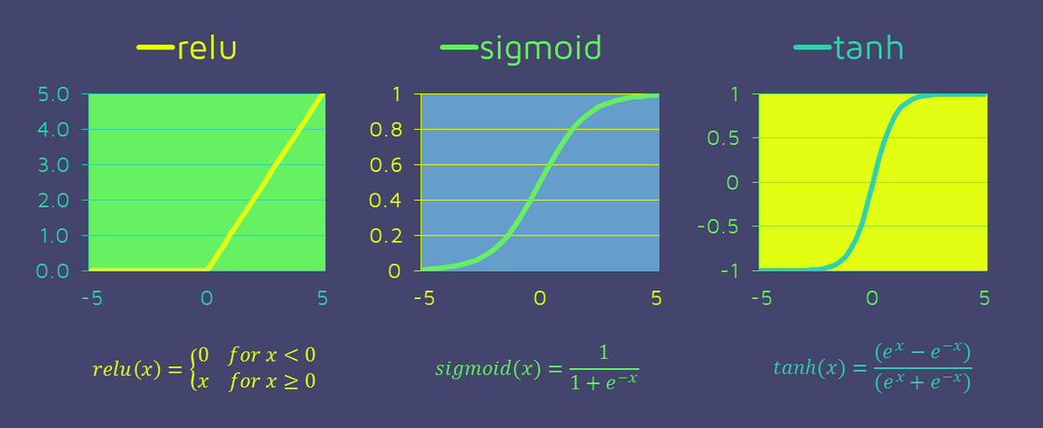
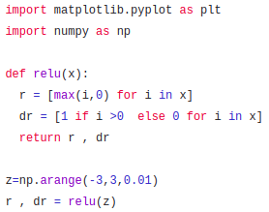
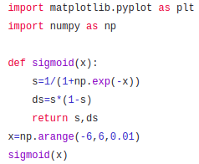
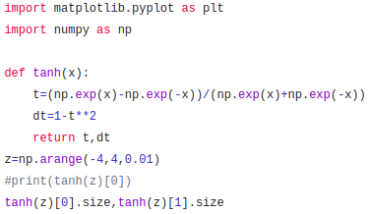
Types of Activation Functions
Non-Linear Activation Function
Sigmoid / Logistic Activation Function
This function takes any real value input and outputs in range of 0 to 1.
As input x becomes larger and positive, the output of the sigmoid function approaches 1, indicating a high probability or likelihood.
It's particularly effective in binary classification tasks, where the output can be interpreted as the probability of belonging to one of two class
Hyperbolic Tangent (Tanh)
The difference from Sigmoid is that output range of -1 to 1. In Tanh, the smaller the input (more negative), the closer the output will be to -1.0.
Output of the tanh is Zero centered; hence we can easily map the output values as strongly negative, neutral, or strongly positive.
ReLU (Rectified Linear Unit)
Unlike a linear function, ReLU has a derivative function and allows for backpropagation while simultaneously making it computationally efficient.
Neurons will only be deactivated if the output of the linear transformation is less than 0.
ReLU accelerates the convergence of gradient descent towards the global minimum of the loss function due to its linear, non-saturating property.
>>> m = nn.ReLU()
>>> input = torch.randn(2)
>>> output = m(input)
>>> m = nn.Sigmoid()
>>> input = torch.randn(2)
>>> output = m(input)
>>> m = nn.Tanh()
i>> input = torch.randn(2)
>>> output = m(input)

Slide 4
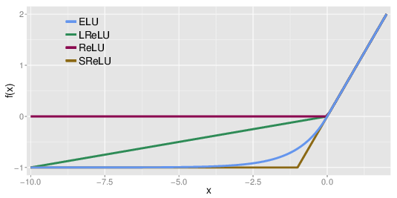
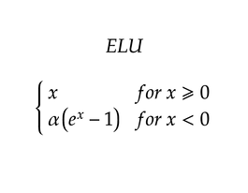
Types of Activation Functions
RELU Variants (Avoiding Dying Relu Problem)
Leaky Relu
Designed to allow a small, non-zero gradient when the input is less than zero. f(x)=x for x>0 x>0 and f(x)=αx for x<0, coefficient α = 0.001.
The gradient of the left side of the graph comes becomes non-zero
LeakyReLU(x)=max(0,x)+negative_slope∗min(0,x)
:
Parametric Relu
For negative Inputs,PReLU allows a small, positive output. This output isn't fixed; it's controlled by slope parameter for negative values α learnt during training. α starts with an initial value (0.01). During back-propagation, α is updated along with other parameters.
PReLU(x)=max(0,x)+a∗min(0,x)
Exponential Linear Units (ELU)
ELU outputs an exponential decay based on the input. Specifically,
f(x)=α(e^x − 1) for x<0, where α is a constant parameter that determines the saturation level for negative inputs
>>> m = nn.LeakyReLU(0.1)
>>> input = torch.randn(2)
>>> output = m(input)
>>> m = nn.PReLU()
>>> input = torch.randn(2)
>>> output = m(input)
>>> m = nn.ELU()
>>> input = torch.randn(2)
>>> output = m(input)

Slide 5
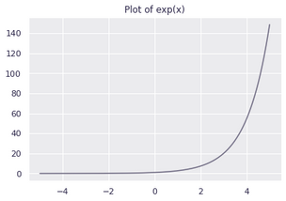
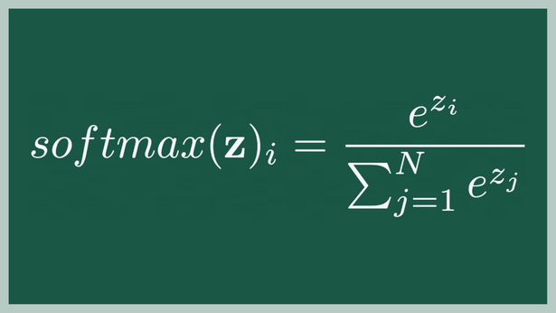
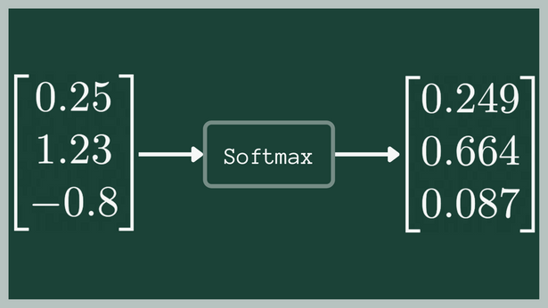
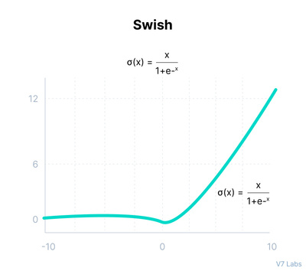
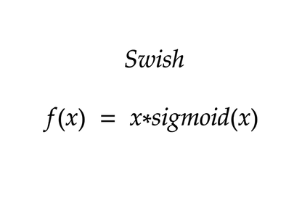
Types of Activation Functions
Non-Linear Activation Function
Softmax Activation Function
Softmax applies a standard exponential function to each element of the output layer, and then normalize them with sum of all the exponentials. output values adds up to 1.
SoftMax function returns the probability of each class.
For multi-class classification, commonly used in the last layer of the neural network.
>>> m = nn.Softmax(dim=1)
>>> input = torch.randn(2, 3)
>>> output = m(input)
Swish Activation
Google researchers found Swish to sometimes outperforms RELU.
Linear and Sigmoid function: inputx by the output of sigmoid function applied to x
For large positive values of x, the sigmoid part approaches 1, allowing most of the input to pass through. For values of x around zero or negative, the sigmoid squashes the output, reducing the influence of those inputs.
The output range is not bounded between 0 and 1 unlike Sigmoid
# Swish Function
class Swish(nn.Module):
def forward(self, x):
return x * torch.sigmoid(x)
Future direction in the research of activation functions
Adaptive and Learnable Activation Functions:
Functions with trainable parameters that adapt (change, optimize) their shape and amplitude to the target dataset e.g Parametric ReLU (PReLU) and Adaptive Piecewise Linear (APL) functions.

Slide 6
Appendix
References:
1. Understanding Convolutional Neural Networks with a Mathematical Model.
C. C. Jay Kuo 2016 https://arxiv.org/pdf/1609.04112.pdf
2. Deep Learning using Rectified Linear Units (ReLU)
Abien Fred M. Agarap https://arxiv.org/pdf/1803.08375.pdf
3. Training Stochastic Model Recognition Algorithms as Networks can lead to Maximum
Mutual Information Estimation of Parameters
John s. Bridle
https://proceedings.neurips.cc/paper_files/paper/1989/file/0336dcbab05b9d5ad24f4333c7658a0e-Paper.pdf
4. The generalized sigmoid activation function: Competitive supervised learning
Sridhar Narayan 1995 https://doi.org/10.1016/S0020-0255(96)00200-9
5. Efficient hardware implementation of the hyperbolic tangent sigmoid function
June 2009
https://www.researchgate.net/publication/224535485_Efficient_hardware_implementation_of_the_hyperbolic_tangent_sigmoid_function
7. Activation functions in Neural Networks
https://www.geeksforgeeks.org/activation-functions-neural-networks
8. Activation Functions in Neural Networks [12 Types & Use Cases]
https://www.geeksforgeeks.org/activation-functions-neural-networks
9. Activation functions in Neural Networks- SAGAR SHARMA
https://towardsdatascience.com/activation-functions-neural-networks-1cbd9f8d91d6

Slide 7
Thank You

